Slide 1

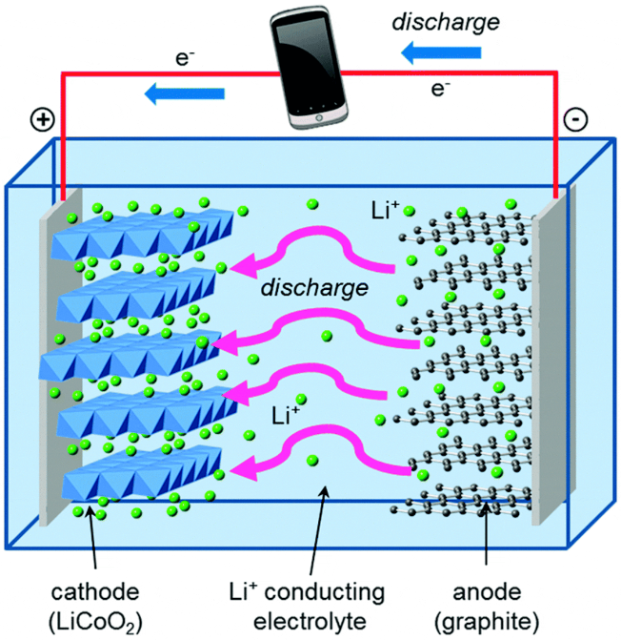
Identifying Degradation Patterns of Lithium-Ion Batteries Using Machine Learning
by Uddiptta Deka

Slide 2
Background on Lithium-Ion Batteries and their Degradation
Lithium-ion batteries are ubiquitous in modern technology, powering everything from smartphones to electric vehicles. However, these batteries are susceptible to degradation over time, leading to reduced performance and lifespan. Understanding the mechanisms of degradation is crucial for extending battery life and ensuring optimal performance.
Electrochemical Processes
Degradation Mechanisms
Key Challange
Lithium-ion batteries function through the movement of lithium ions between the anode and cathode during charge and discharge cycles. During charging, lithium ions move from the positive electrode (cathode) to the negative electrode (anode) and store energy. During discharging, the ions flow back to the cathode, releasing energy to power devices.
Battery degradation arises from solid-electrolyte interphase (SEI) layer growth, which consumes lithium ions and reduces capacity. Lithium plating can also occur, leading to capacity loss and potential short circuits. Structural changes in the electrodes cause active material loss, while electrolyte decomposition increases internal resistance, all contributing to overall battery degradation.
Accurate prediction of a battery's state of health (SOH) and remaining useful life (RUL) is crucial for timely replacements, helping prevent unexpected capacity loss. Additionally, precise battery prognosis is essential for the recycling sector, guiding decisions on whether a battery should be recycled as scrap metal or repurposed for "second-life" applications.

Slide 3

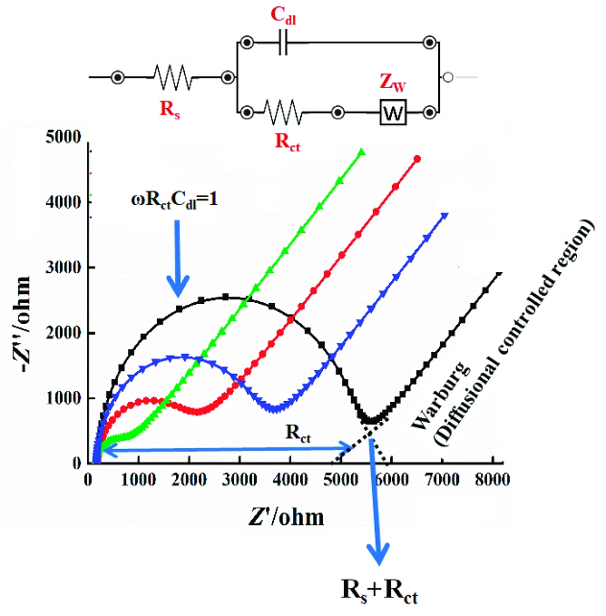
Electrochemical Impedance Spectroscopy as a Tool for Battery Analysis
Traditional battery forecasting models microscopic degradation mechanisms like SEI growth, lithium plating, and active material loss. While these models provide physical insights, they are unscalable due to their complexity. Recent approaches focuses on data-driven approaches use statistical machine learning to relate those measurements to battery health without modelling a physical mechanism. The challenge lies in selecting informative inputs and developing robust statistical models.
Electrochemical Impedance Spectroscopy(EIS)
It measures a battery's impedance across a broad frequency range, offering detailed insights into its material properties, interfacial phenomena, and electrochemical reactions. This comprehensive data helps assess battery health, detect degradation mechanisms, and track overall performance.
Why EIS as input?
Compared with the usual current–voltage data, It contains rich information on all materials properties, interfacial phenomena and electrochemical reactions. This directly relates to possible degradation inside the battery and is able to track the status of the battery.

Slide 4


Data Collection and Preprocessing
The research paper emphasizes the importance of data collection and preprocessing for ensuring the accuracy and reliability of machine learning models used for battery degradation analysis. Data quality is the foundation of effective machine learning (ML) solutions. High-quality data helps models learn accurate patterns, which leads to more reliable predictions and insights.
1
Data Acquisition
Over 20,000 EIS spectra of commercial Li-ion batteries are collected at different states of health, states of charge and temperatures—the largest dataset to our knowledge of its kind.
2
Data Quality
Deploying EIS to predictive battery diagnosis is hampered by the high dimensionality of the spectrum. Although qualitative changes are apparent, it is challenging to pick out quantitative features correlated with degradation.
3
Feature Engineering
Existing approaches reduce the spectrum into lower dimensional features: the spectrum is either interpreted by fitting to an equivalent circuit ,the fit is often non-unique and it is questionable whether a purely electrical model can capture the physical, chemical and materials properties and processes of a battery.

Slide 5


Feature Extraction and Model Selection
Recent advances in machine learning allow models to process entire datasets without manually selecting features, enabling the models to identify the most relevant variables themselves. This eliminates the need of selecting features correlated with degradation.
Gaussian Process Regression (GPR)
Gaussian Process Regression (GPR) is a non-parametric regression technique, particularly useful when dealing with problems involving continuous data, where the relationship between input variables and output is not explicitly known or can be complex.
GPR depicts a group of random variables, each of which has a joint Gaussian distribution and can have a finite number. It’s an effective technique for modeling intricate relationships in data and producing forecasts with related uncertainty.
GPR can accurately estimate the capacity and predict RUL using the EIS spectrum, which are key indicators of the SOH of a battery. Our model is more accurate than conventional methods, which use features of the discharging curve

Slide 6

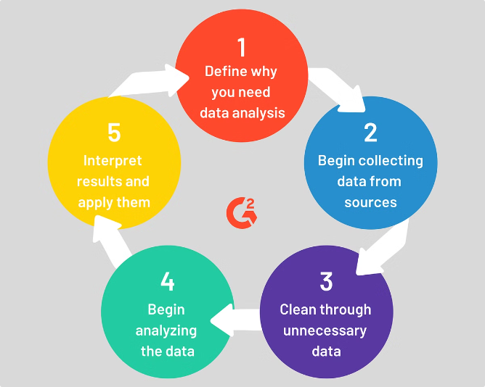

Overview of the Machine Learning Approach
The research paper proposes a machine learning approach for analyzing impedance spectra to identify and predict battery degradation patterns. This approach leverages the power of data-driven algorithms to extract meaningful insights from complex impedance data, providing a more accurate and robust method for battery health monitoring.
1
Data Driven Approach
2
Predictive Capabilities
Machine learning algorithms excel at finding hidden patterns and relationships in complex datasets, making them well-suited for analyzing impedance spectra and identifying degradation trends.
By training machine learning models on impedance data, researchers can develop predictive models that estimate battery health and remaining useful life, enabling proactive battery management.
3
Model Training
4
Feature Engineering
The research paper utilizes various machine learning algorithms, such as support vector machines and neural networks, to train models capable of identifying degradation patterns and predicting future performance.
Key features extracted from the impedance spectra are used to train the machine learning models, ensuring that the algorithms capture the most relevant information for predicting battery degradation.

Slide 7

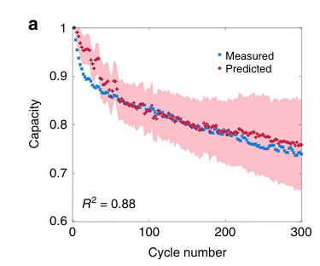

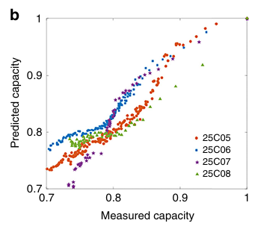

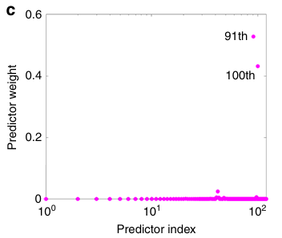

Results and Key Findings
Capacity estimation:
We train the EIS-Capacity GPR model on four cells cycled at room temperature of 25°C (marked as 25C01–25C04), then test it on the other four cells (marked as 25C05–25C08).
Figure 1a shows the result for the 25C05 cell in state V (15 minutes after full charging). The model performs best in stable states, like V and IX, where the battery is fully charged or discharged after resting, leading to more consistent measurements.
Figure 1b shows the measured capacity against the estimated capacity of all four testing cells. We note that all testing cells are charged and discharged the same way as the training cells; the ability of our model to estimate the cells cycled at different operating charge/discharge rates needs to be investigated by further experiments.
Figure 1c shows the automatic relevance determination (ARD) importance weights of the EIS-Capacity GPR model. Interestingly, the model finds that only two salient frequencies, out of the 120 possibilities in the range of 0.02 Hz–20kHz, are sufficient to estimate capacity

Slide 8
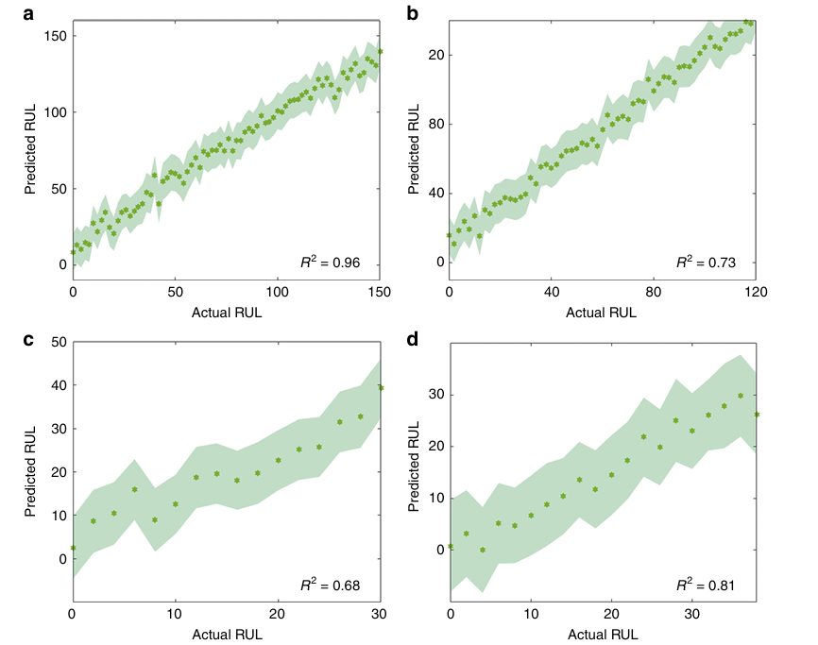
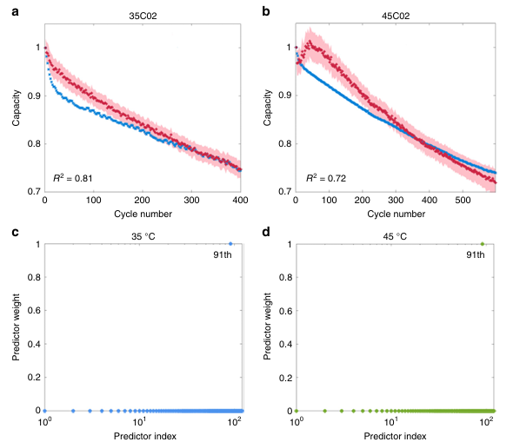
Results and Key Findings
Capacity estimation and RUL prediction at multiple temperatures:
RUL prediction:
The goal of a battery management system is to predict the remaining useful life (RUL) and detect issues from battery aging or abuse. Our EIS-RUL GPR model accurately predicts RUL using only current cycle EIS measurements, with no need for data from previous cycles. Figure 2 demonstrates this capability for four testing cells at 25°C. This indicates that our technology could be developed into an effective battery management system for real-world use.
Battery diagnosis is challenging due to varying operating conditions, like temperature. In this study, we simplified the problem by assuming a constant temperature during cycling (25°C, 35°C, or 45°C). We combined data from these temperatures and trained a GPR model to predict RUL based on EIS measurements. Figures 3a and 3b show that the model effectively estimates capacity for cells at 35°C and 45°C. Using the ARD method, Figures 3c and 3d reveal that the model relies on a single frequency (17.80 Hz) to estimate capacity, consistent with previous findings.

Slide 9


Conclusion and Future Research Directions
his paper demonstrates that our GPR models accurately estimate battery capacity and predict RUL using EIS spectra, even for cells with different degradation patterns and temperatures, as long as the charge/discharge rates remain constant. Our method can assess battery state and RUL from a single impedance measurement without knowing the cycling temperature, provided future temperatures are similar. Our key findings are-
Accurate Estimation: GPR models effectively estimate battery capacity and predict RUL using EIS spectra, even with different degradation patterns and temperatures, as long as charge/discharge rates are constant.
Temperature Independence: The model predicts state of health (SoH) and RUL from a single impedance measurement without knowing cycling temperature, provided future temperatures are similar.
Predictive Features: Low-frequency EIS data is most predictive of battery capacity and RUL.
Feature Identification: GPR with an ARD kernel identifies important features from high-dimensional measurements.
Future Directions: Potential to extend findings to more complex scenarios, such as varying temperatures and charge rates, with a need for a larger training set.

